Slide 1
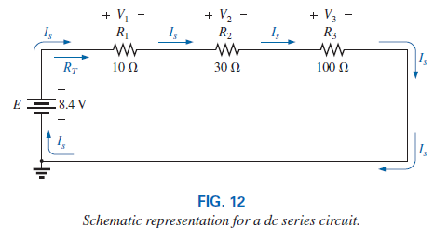
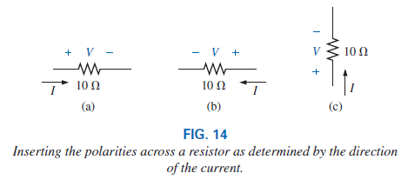
College of Engineering Dept. of the electrical power and Machine engineering
Subject / Electrical Eng. Fundamental I
Series dc Circuits
stage / first Date: 15/11/2018 Lecture:4
Time/ 2 hours
SERIES RESISTORS
SERIES CIRCUITS
A circuit is any combination of elements that will result in a continuous flow of charge, or current, through the configuration
the direction of conventional current in a series dc circuit is such that it leaves the positive terminal of the supply and returns to the negative terminal, as shown in Fig. 12.
The current is the same at every point in a series circuit. In any configuration, if two elements are in series, the current must be the same. However, if the current is the same for two adjoining elements, the elements may or may not be in series.
•
the polarity of the voltage across a resistor is determined by the direction of the current

Slide 2
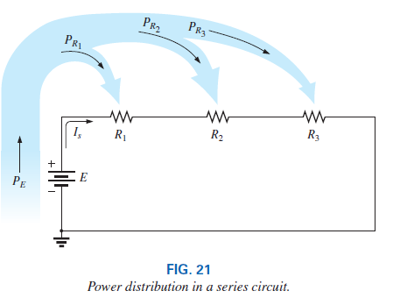
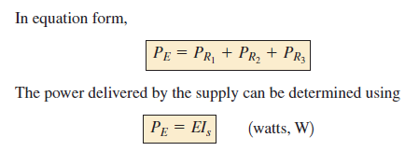
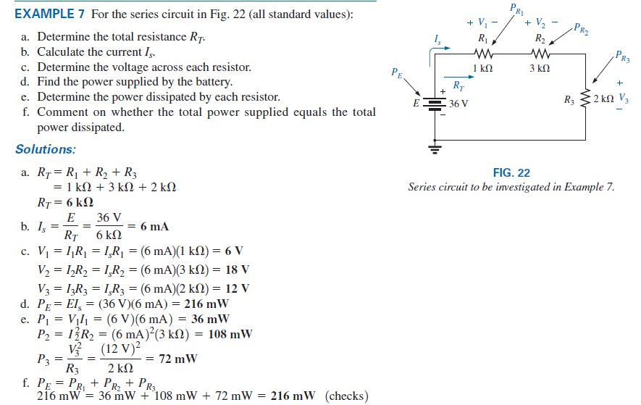
College of Engineering Dept. of the electrical power and Machine engineering
Subject / Electrical Eng. Fundamental I
stage / first Date: 15/11/2018 Lecture:4
Time/ 2 hours
POWER DISTRIBUTION IN A SERIES CIRCUIT
the power applied by the dc supply must equal that dissipated by the resistive elements.
in a series configuration, maximum power is delivered to the largest resistor

Slide 3
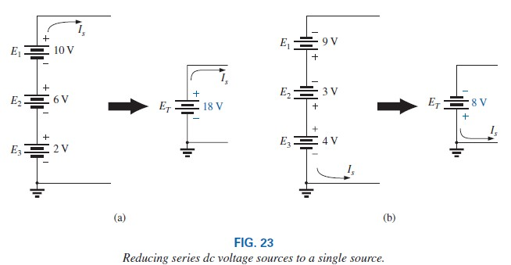
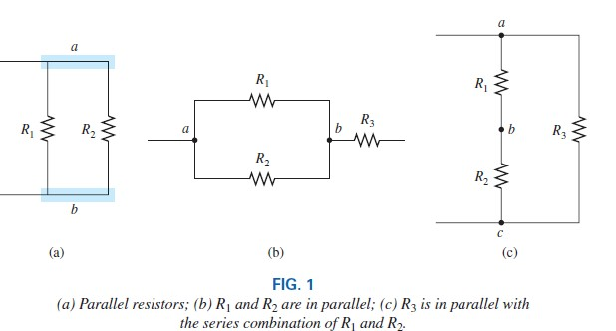
College of Engineering Dept. of the electrical power and Machine engineering
Subject / Electrical Eng. Fundamental I
VOLTAGE SOURCES IN SERIES
stage / first Date: 15/11/2018 Lecture:4
Time/ 2 hours
Parallel dc Circuits
two elements, branches, or circuits are in parallel if they have two points in common.

Slide 4
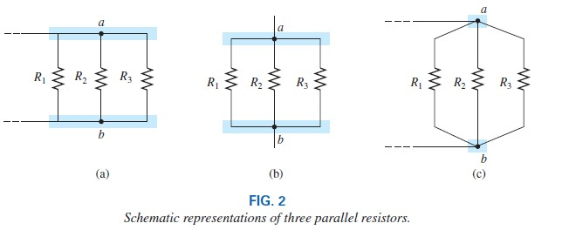
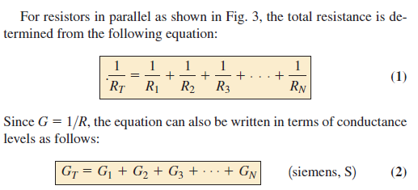
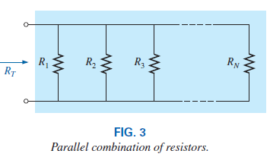
College of Engineering Dept. of the electrical power and Machine engineering
Subject / Electrical Eng. Fundamental I
stage / first Date: 15/11/2018 Lecture:4
Time/ 2 hours

Slide 5
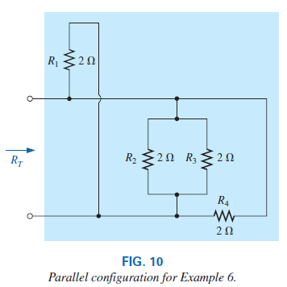
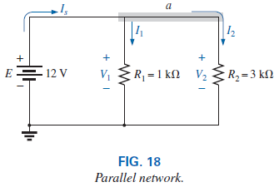
College of Engineering Dept. of the electrical power and Machine engineering
Subject / Electrical Eng. Fundamental I
EXAMPLE 6 Find the total resistance for the configuration in Fig. 10.
stage / first Date: 15/11/2018 Lecture:4
Time/ 2 hours
Two Parallel Resistors
PARALLEL CIRCUITS
the voltage is always the same across parallel elements.
Therefore, remember that
if two elements are in parallel, the voltage across them must be the same. However, if the voltage across two neighboring elements is the same, the two elements may or may not be in parallel.

Slide 6
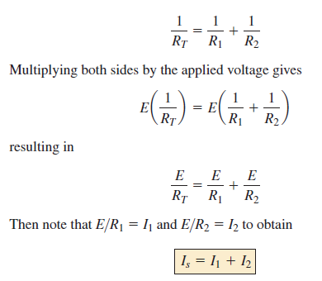
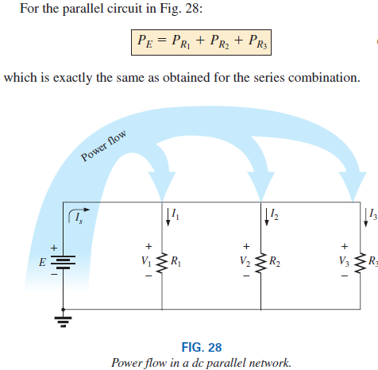
College of Engineering Dept. of the electrical power and Machine engineering
Subject / Electrical Eng. Fundamental I
stage / first Date: 15/11/2018 Lecture:4
Time/ 2 hours
For single-source parallel networks, the source current (Is) is always equal to the sum of the individual branch currents.
POWER DISTRIBUTION IN A PARALLEL CIRCUIT
for any network composed of resistive elements, the power applied by the battery will equal that dissipated by the resistive elements

